Slide 1
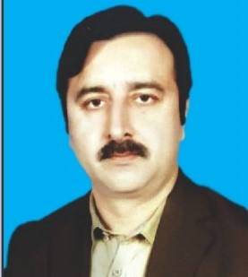
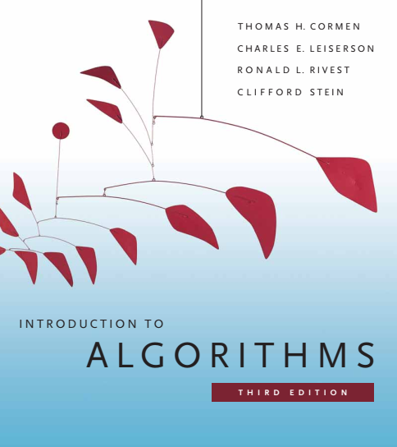
Design and Analysis of Algorithms
Dr. Sajid Iqbal
sajidiqbal.pk@gmail.com
Reference Book
Introduction to Algorithms 3rd Edition By Thomas H. Cormen et. al.
https://mitpress.mit.edu/books/introduction-algorithms-third-edition
COMEDXD

Slide 2
Matrix Multiplication
An application of divide and conquer Technique

Slide 3
Background
Break the problem into a number of subproblems that are smaller instances of the same problem
Conquer
Solve the sub-problems recursively. Solve the smallest problems directly
Combine
Combine the solutions to the subproblems into the solution for the original problem
Divide
Divide-n-Conquer consists of three phases

Slide 4
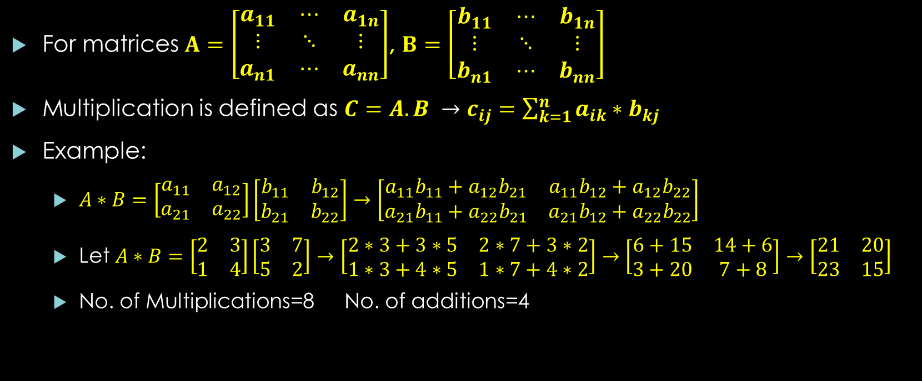
Problem Background
For matrices $A=\left[\begin{matrix}a_{11} & ⋯ & a_{1n} \\ ⋮ & ⋱ & ⋮ \\ a_{n1} & ⋯ & a_{nn}\end{matrix}\right]$, $B=\left[\begin{matrix}b_{11} & ⋯ & b_{1n} \\ ⋮ & ⋱ & ⋮ \\ b_{n1} & ⋯ & b_{nn}\end{matrix}\right]$
Multiplication is defined as $C=A.B →$ $c_{ij}=\sum_{k=1}^{n}{a_{ik}∗b_{kj}}$
Example:
$A∗B=\left[\begin{matrix}a_{11} & a_{12} \\ a_{21} & a_{22}\end{matrix}\right]\left[\begin{matrix}b_{11} & b_{12} \\ b_{21} & b_{22}\end{matrix}\right]→\left[\begin{matrix}a_{11}b_{11}+a_{12}b_{21} & a_{11}b_{12}+a_{12}b_{22} \\ a_{21}b_{11}+a_{22}b_{21} & a_{21}b_{12}+a_{22}b_{22}\end{matrix}\right]$
Let $A∗B=\left[\begin{matrix}2 & 3 \\ 1 & 4\end{matrix}\right]\left[\begin{matrix}3 & 7 \\ 5 & 2\end{matrix}\right]→\left[\begin{matrix}2∗3+3∗5 & 2∗7+3∗2 \\ 1∗3+4∗5 & 1∗7+4∗2\end{matrix}\right]→\left[\begin{matrix}6+15 & 14+6 \\ 3+20 & 7+8\end{matrix}\right]→\left[\begin{matrix}21 & 20 \\ 23 & 15\end{matrix}\right]$
No. of Multiplications=8 No. of additions=4

Slide 5

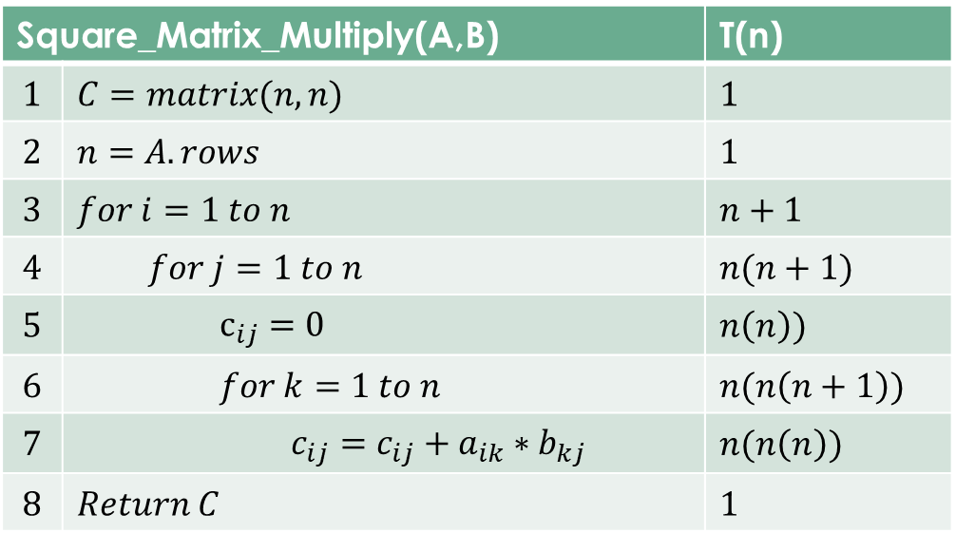
Matrices Multiplication Algorithm
So the time complexity is
$T\left(n\right)=1+1+\left(n+1\right)+n\left(n+1\right)+n(n)+n(n\left(n+1\right)+n\left(n\left(n\right)\right)+1$
$T\left(n\right)=3+n+1+n^{2}+n+n^{2}+n^{3}+n^{2}+n^{3}$
$T\left(n\right)=4+2n+3n^{2}+2n^{3}$
$T(n)=θ(n^{3})$
Square_Matrix_Multiply(A,B) |  | T(n)
$$1$$ | $$C=matrix(n,n)$$ | $$1$$
$$2$$ | $$n=A.rows$$ | $$1$$
$$3$$ | $$for i=1 to n$$ | $$n+1$$
$$4$$ | $$for j=1 to n$$ | $$n(n+1)$$
$$5$$ | $$c_{ij}=0$$ | $$n\left(n\right))$$
$$6$$ | $$for k=1 to n$$ | $$n(n\left(n+1\right))$$
$$7$$ | $$c_{ij}=c_{ij}+a_{ik}∗b_{kj}$$ | $$n(n\left(n\right))$$
$$8$$ | $$Return C$$ | $$1$$
$$A∗B=\left[\begin{matrix}a_{11} & a_{12} \\ a_{21} & a_{22}\end{matrix}\right]\left[\begin{matrix}b_{11} & b_{12} \\ b_{21} & b_{22}\end{matrix}\right]→\left[\begin{matrix}a_{11}b_{11}+a_{12}b_{21} & a_{11}b_{12}+a_{12}b_{22} \\ a_{21}b_{11}+a_{22}b_{21} & a_{21}b_{12}+a_{22}b_{22}\end{matrix}\right]$$

Slide 6
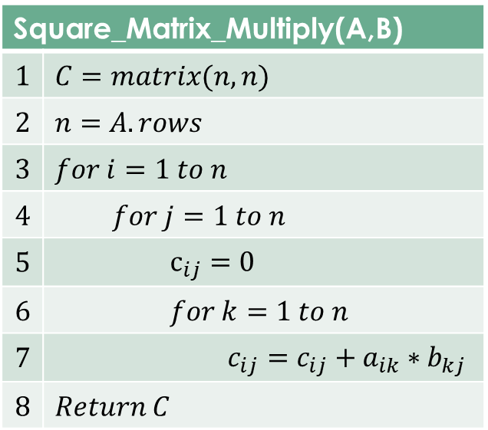
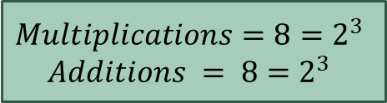
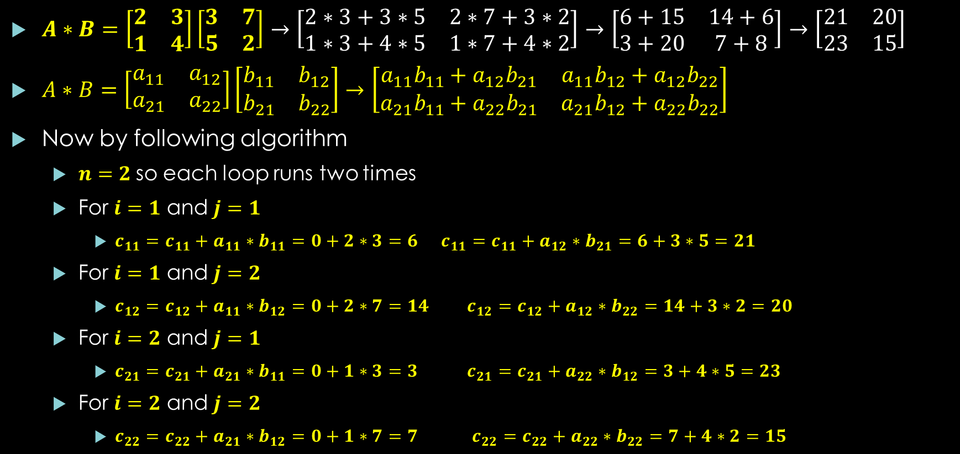
Illustrated Example
$A∗B=\left[\begin{matrix}2 & 3 \\ 1 & 4\end{matrix}\right]\left[\begin{matrix}3 & 7 \\ 5 & 2\end{matrix}\right]→\left[\begin{matrix}2∗3+3∗5 & 2∗7+3∗2 \\ 1∗3+4∗5 & 1∗7+4∗2\end{matrix}\right]→\left[\begin{matrix}6+15 & 14+6 \\ 3+20 & 7+8\end{matrix}\right]→\left[\begin{matrix}21 & 20 \\ 23 & 15\end{matrix}\right]$
$A∗B=\left[\begin{matrix}a_{11} & a_{12} \\ a_{21} & a_{22}\end{matrix}\right]\left[\begin{matrix}b_{11} & b_{12} \\ b_{21} & b_{22}\end{matrix}\right]→\left[\begin{matrix}a_{11}b_{11}+a_{12}b_{21} & a_{11}b_{12}+a_{12}b_{22} \\ a_{21}b_{11}+a_{22}b_{21} & a_{21}b_{12}+a_{22}b_{22}\end{matrix}\right]$
Now by following algorithm
$n=2$so each loop runs two times
For $i=1$ and $j=1$
$c_{11}=c_{11}+a_{11}∗b_{11}=0+2∗3=6$ $c_{11}=c_{11}+a_{12}∗b_{21}=6+3∗5=21$
For $i=1$ and $j=2$
$c_{12}=c_{12}+a_{11}∗b_{12}=0+2∗7=14$ $c_{12}=c_{12}+a_{12}∗b_{22}=14+3∗2=20$
For $i=2$ and $j=1$
$c_{21}=c_{21}+a_{21}∗b_{11}=0+1∗3=3$ $c_{21}=c_{21}+a_{22}∗b_{12}=3+4∗5=23$
For $i=2$ and $j=2$
$c_{22}=c_{22}+a_{21}∗b_{12}=0+1∗7=7$ $c_{22}=c_{22}+a_{22}∗b_{22}=7+4∗2=15$
$$Multiplications=8=2^{3}$$
$$Additions = 8=2^{3}$$

Slide 7
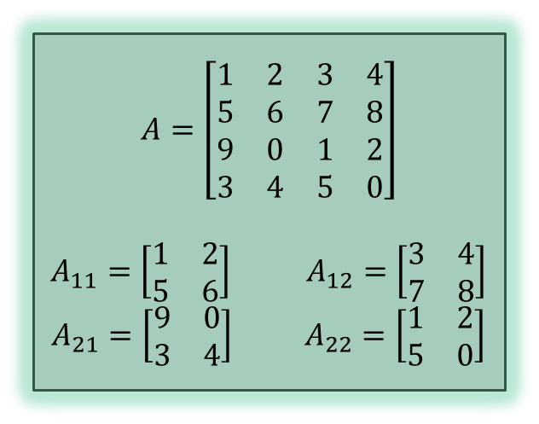


Divide and Conquer Method for Matrix Multiplication
Let we have two matrices $A,B$ and $C$ to multiply
For simplicity we assume that each matrix has $n=2^{i}$ elements
Suppose that we partition each of $A,B,C$ matrix into four parts each of size $n/2$
$A=\left(\begin{matrix}A_{11} & A_{12} \\ A_{21} & A_{22}\end{matrix}\right)$ $B=\left(\begin{matrix}B_{11} & B_{12} \\ B_{21} & B_{22}\end{matrix}\right)$ $C=\left(\begin{matrix}C_{11} & C_{12} \\ C_{21} & C_{22}\end{matrix}\right)$
$C=A.B$ $\left(\begin{matrix}C_{11} & C_{12} \\ C_{21} & C_{22}\end{matrix}\right)=\left(\begin{matrix}A_{11} & A_{12} \\ A_{21} & A_{22}\end{matrix}\right)∗\left(\begin{matrix}B_{11} & B_{12} \\ B_{21} & B_{22}\end{matrix}\right)$
$C_{11}=A_{11}∗B_{11}+A_{12}∗B_{21}$
$C_{12}=A_{11}∗B_{12}+A_{12}∗B_{22}$
$C_{21}=A_{21}∗B_{11}+A_{22}∗B_{21}$
$C_{22}=A_{21}∗B_{12}+A_{22}∗B_{22}$
$$A=\left[\begin{matrix}1 & 2 & 3 & 4 \\ 5 & 6 & 7 & 8 \\ 9 & 0 & 1 & 2 \\ 3 & 4 & 5 & 0\end{matrix}\right]$$
$A_{11}=\left[\begin{matrix}1 & 2 \\ 5 & 6\end{matrix}\right]$ $A_{12}=\left[\begin{matrix}3 & 4 \\ 7 & 8\end{matrix}\right]$
$A_{21}=\left[\begin{matrix}9 & 0 \\ 3 & 4\end{matrix}\right]$ $A_{22}=\left[\begin{matrix}1 & 2 \\ 5 & 0\end{matrix}\right]$
$$1(8x8)$$
$$1(4(4x4))$$
$$1(4(4\left(2x2\right)))$$
$$1(4(4\left(4\left(1x1\right)\right)))$$

Slide 8

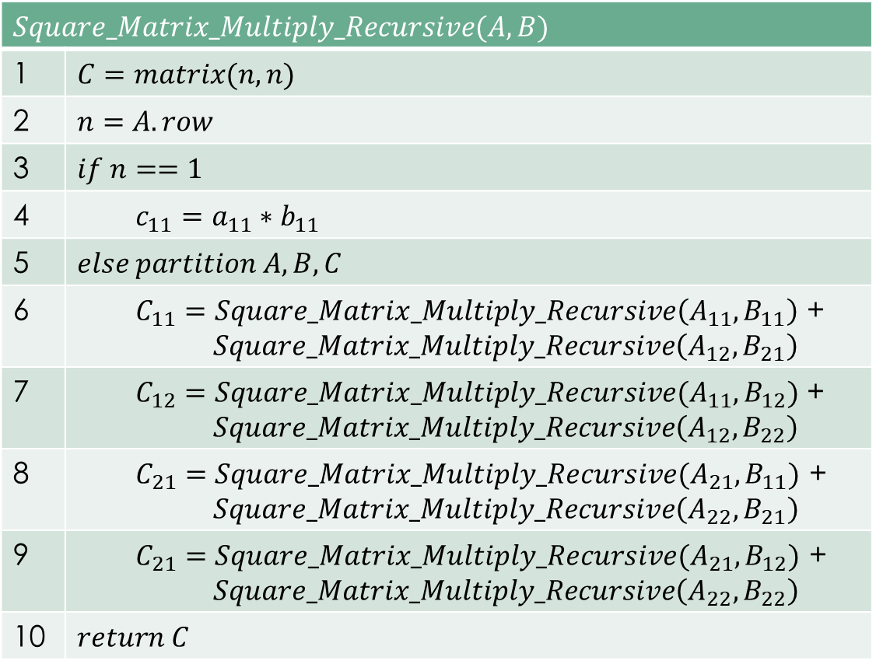
Recursive Matrix Multiplication
$$Square_Matrix_Multiply_Recursive(A,B)$$
1 | $$C=matrix(n,n)$$
2 | $$n=A.row$$
3 | $$if n==1$$
4 | $$c_{11}=a_{11}∗b_{11}$$
5 | $$else partition A,B,C$$
6 | $C_{11}=Square_Matrix_Multiply_Recursive\left(A_{11},B_{11}\right)$ + $$Square_Matrix_Multiply_Recursive\left(A_{12},B_{21}\right)$$
7 | $C_{12}=Square_Matrix_Multiply_Recursive(A_{11},B_{12})$ + $$Square_Matrix_Multiply_Recursive\left(A_{12},B_{22}\right)$$
8 | $$C_{21}=Square_Matrix_Multiply_Recursive(A_{21},B_{11})\text{ +}$$ $$Square_Matrix_Multiply_Recursive\left(A_{22},B_{21}\right)$$
9 | $$C_{21}=Square_Matrix_Multiply_Recursive(A_{21},B_{12})\text{ +}$$ $$Square_Matrix_Multiply_Recursive\left(A_{22},B_{22}\right)$$
10 | $$return C$$
$$C_{11}=A_{11}∗B_{11}+A_{12}∗B_{21}$$
$$C_{12}=A_{11}∗B_{12}+A_{12}∗B_{22}$$
$$C_{21}=A_{21}∗B_{11}+A_{22}∗B_{21}$$
$$C_{22}=A_{21}∗B_{12}+A_{22}∗B_{22}$$

Slide 9
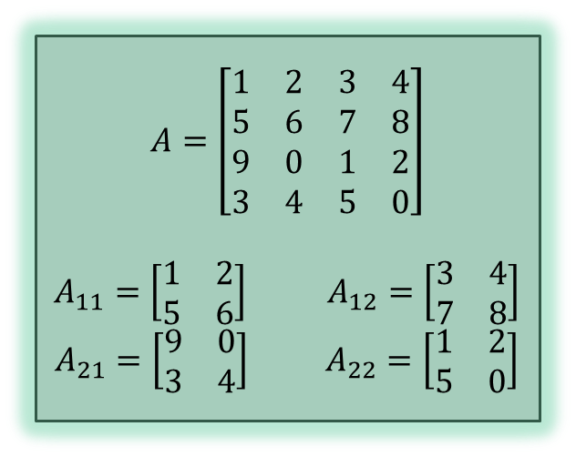



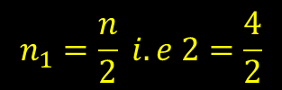

Partitioning the Matrix
$$\left[\begin{matrix}a_{11} & a_{12} & a_{13} & a_{14} \\ a_{21} & a_{22} & a_{23} & a_{24} \\ a_{31} & a_{32} & a_{33} & a_{34} \\ a_{41} & a_{42} & a_{43} & a_{44}\end{matrix}\right]$$
$$n_{1}=\frac{n}{2} i.e 2=\frac{4}{2}$$
$$A=\left[\begin{matrix}1 & 2 & 3 & 4 \\ 5 & 6 & 7 & 8 \\ 9 & 0 & 1 & 2 \\ 3 & 4 & 5 & 0\end{matrix}\right]$$
$A_{11}=\left[\begin{matrix}1 & 2 \\ 5 & 6\end{matrix}\right]$ $A_{12}=\left[\begin{matrix}3 & 4 \\ 7 & 8\end{matrix}\right]$
$A_{21}=\left[\begin{matrix}9 & 0 \\ 3 & 4\end{matrix}\right]$ $A_{22}=\left[\begin{matrix}1 & 2 \\ 5 & 0\end{matrix}\right]$
For $A_{11}$
$a_{11},a_{12},a_{21},a_{22}$
$for i in n_{1}$
$for j in n_{1}$
$A_{{11}_{ij}}= a_{ij}$
For $A_{12}$
$a_{13},a_{14},a_{23},a_{24}$
$for i in n_{1}$
$for j=\left(n_{1}∗2+1\right) to (n_{1}∗2+n_{1})$
$A_{{12}_{ij}}= a_{ij}$
For $A_{21}$
$a_{31},a_{32},a_{41},a_{42}$
$for i=\left(n_{1}∗2+1\right) to (n_{1}∗2+n_{1})$
$for j in n_{1}$
$A_{{11}_{ij}}= a_{ij}$
For $A_{22}$
$a_{33},a_{34},a_{43},a_{44}$
$for i=\left(n_{1}∗2+1\right) to (n_{1}∗2+n_{1})$
$for j=\left(n_{1}∗2+1\right) to (n_{1}∗2+n_{1})$
$A_{{12}_{ij}}= a_{ij}$
Time Complexity is $θ(n^{2})$

Slide 10
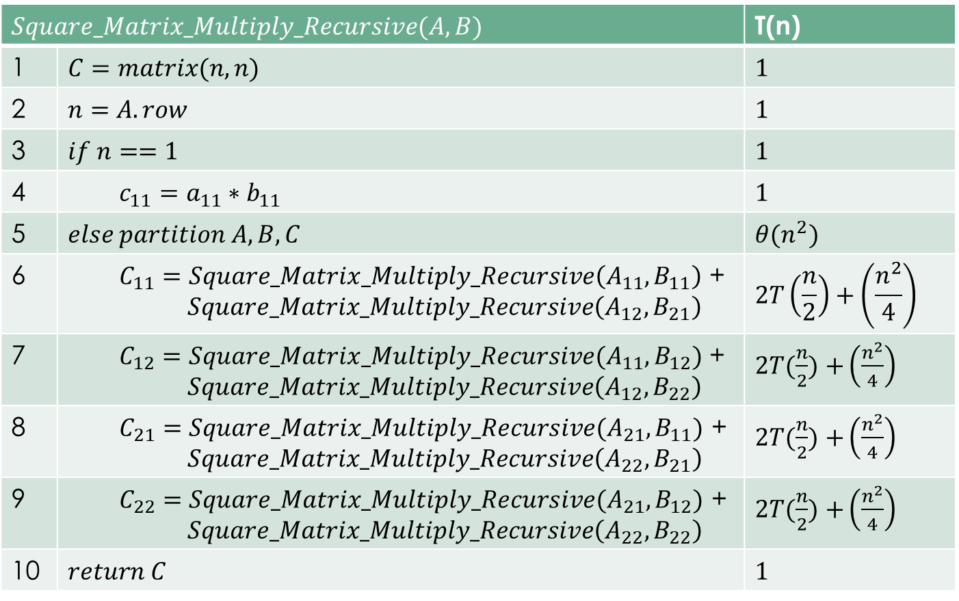
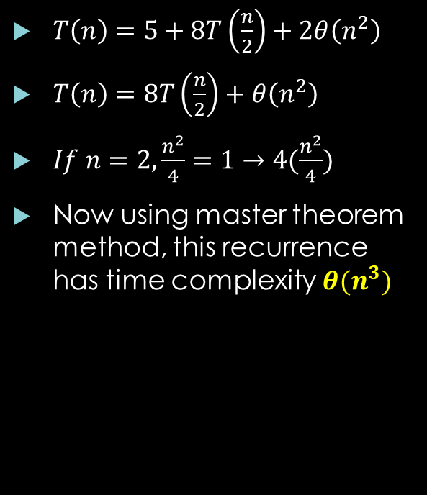
Time Complexity of Recursive Matrices Multiplication
$$Square_Matrix_Multiply_Recursive(A,B)$$ |  | T(n)
1 | $$C=matrix(n,n)$$ | $$1$$
2 | $$n=A.row$$ | $$1$$
3 | $$if n==1$$ | $$1$$
4 | $$c_{11}=a_{11}∗b_{11}$$ | $$1$$
5 | $$else partition A,B,C$$ | $$θ(n^{2})$$
6 | $C_{11}=Square_Matrix_Multiply_Recursive\left(A_{11},B_{11}\right)$ + $$Square_Matrix_Multiply_Recursive\left(A_{12},B_{21}\right)$$ | $$2T\left(\frac{n}{2}\right)+\left(\frac{n^{2}}{4}\right)$$
7 | $C_{12}=Square_Matrix_Multiply_Recursive(A_{11},B_{12})$ + $$Square_Matrix_Multiply_Recursive\left(A_{12},B_{22}\right)$$ | $2T(\frac{n}{2})$ $+\left(\frac{n^{2}}{4}\right)$
8 | $$C_{21}=Square_Matrix_Multiply_Recursive(A_{21},B_{11})\text{ +}$$ $$Square_Matrix_Multiply_Recursive\left(A_{22},B_{21}\right)$$ | $2T(\frac{n}{2})$ $+\left(\frac{n^{2}}{4}\right)$
9 | $$C_{22}=Square_Matrix_Multiply_Recursive(A_{21},B_{12})\text{ +}$$ $$Square_Matrix_Multiply_Recursive\left(A_{22},B_{22}\right)$$ | $2T(\frac{n}{2})$ $+\left(\frac{n^{2}}{4}\right)$
10 | $$return C$$ | $$1$$
$T\left(n\right)=5+8T\left(\frac{n}{2}\right)+2θ\left(n^{2}\right)$
$T\left(n\right)=8T\left(\frac{n}{2}\right)+θ\left(n^{2}\right)$
$If n=2,\frac{n^{2}}{4}=1→4(\frac{n^{2}}{4})$
Now using master theorem method, this recurrence has time complexity $θ(n^{3})$

Slide 11
Matrix Multiplication Using Loops
import numpy as np def multiply_matrices(A,B): row,col=A.shape C=np.zeros((A.shape)) for i in range(row): for j in range(col): C[i,j]=0 for k in range(col): C[i,j]=C[i,j]+A[i,k]*B[k,j] return C A=np.asarray([[2,3],[1, 4]]) B=np.asarray([[3,7],[5,2]]) C=multiply_matrices(A,B) print(C)

Slide 12
Matrix Multiplication Using Recursion
# Driver Code
def Square_Matrix_Multiply_Recursive(A,B): C=np.zeros((A.shape)) row,col=A.shape if row==1 and col==1: C[0,0]=A[0,0]*B[0,0] return C else: A11, A12, A21, A22 = Partition_Matrix(A) B11, B12, B21, B22 = Partition_Matrix(B) C11, C12, C21, C22 = Partition_Matrix(C) C11 = Square_Matrix_Multiply_Recursive(A11, B11) + \ Square_Matrix_Multiply_Recursive(A12, B21) C12 = Square_Matrix_Multiply_Recursive(A11, B12) + \ Square_Matrix_Multiply_Recursive(A12, B22) C21 = Square_Matrix_Multiply_Recursive(A21, B11) + \ Square_Matrix_Multiply_Recursive(A22, B21) C22 = Square_Matrix_Multiply_Recursive(A21, B12) + \ Square_Matrix_Multiply_Recursive(A22, B22) C=np.asanyarray([[C11[0][0],C12[0][0]],[C21[0][0],C22[0][0]]]) return C
import numpy as np def Partition_Matrix(A): # we assume that we have squared matrix # that has size=power of 2, i.e. 2,4,8,16,... row,col=A.shape n=row half_n=n//2 A11=A[0:half_n,0:half_n] A12=A[0:half_n,half_n:n] A21=A[half_n:n,0:half_n] A22=A[half_n:n,half_n:n] #print(A11,A12,A21,A22) return A11,A12,A21,A22
# Driver Code
A=np.asarray([[2,3],[1,4]]) B=np.asarray([[3,7],[5,2]]) C=Square_Matrix_Multiply_Recursive(A,B) print(C)

Slide 13

Thanks for watching
Dr. Sajid Iqbal
Assistant Professor
Department of Computer Science
Bahauddin Zakariya University, Multan
sajidiqbal.pk@gmail.com
YouTube Channel: COMEDXD
Allah Hafiz

